Slide 1
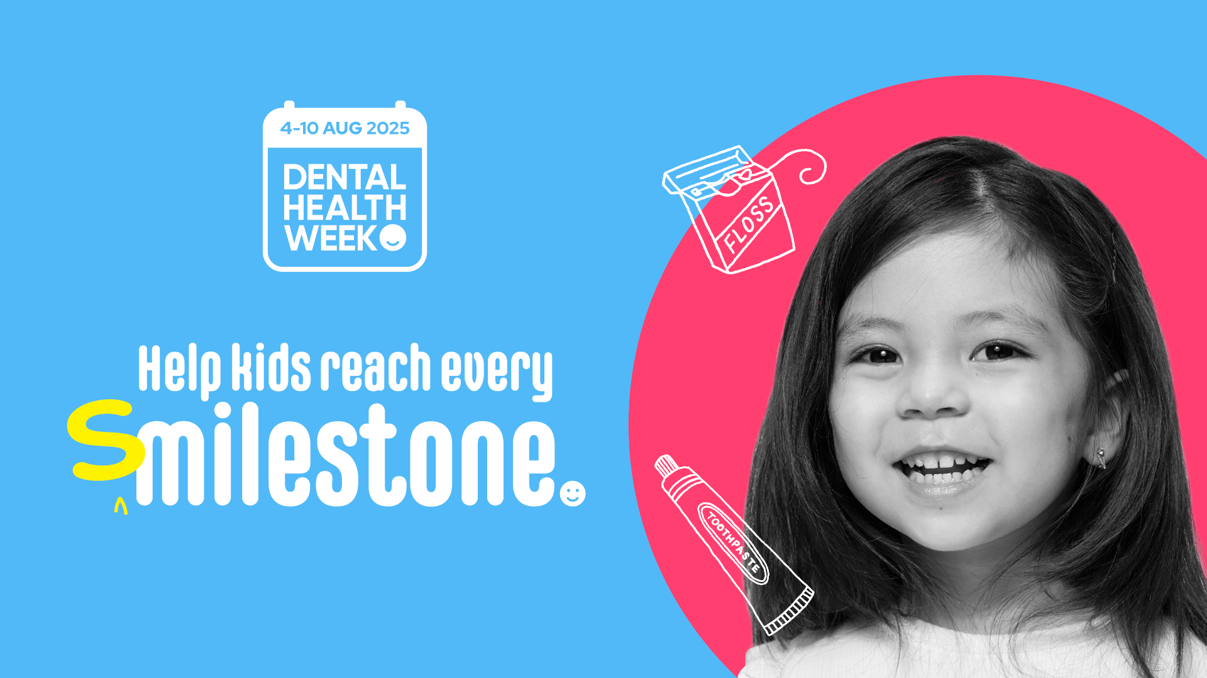
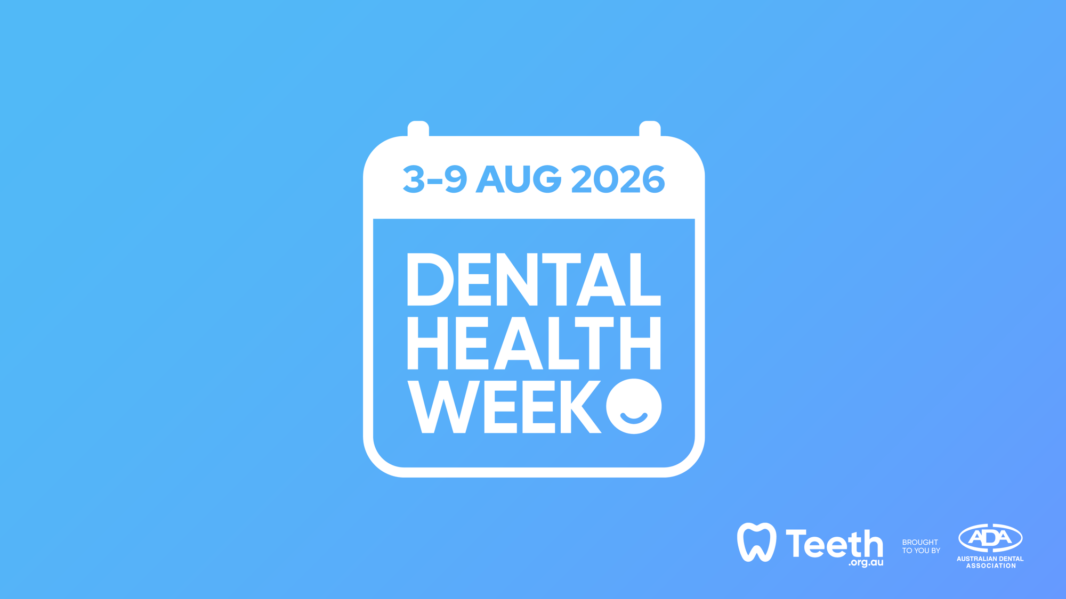

Slide 2
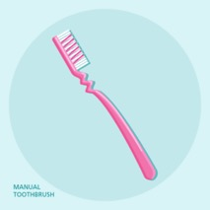
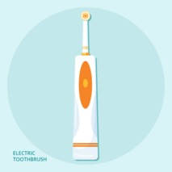
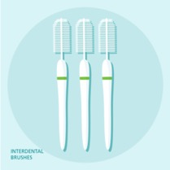
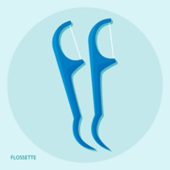
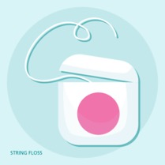
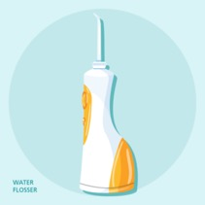
General principles for caring for your teeth at 18-25 years old
Brush two times every day
  Use fluoride toothpaste
  Brush in the morning and at night just before bed
Clean between your teeth every day

Slide 3
I've got that all down pat... so what's next for me?
Wisdom teeth – impaction, reasons for impaction and
management (extractions)
Cosmetic dentistry – DIY or professional whitening, orthodontics/teeth straightening and crowns/veneers
Sports – trauma, mouthguards, sports/energy drinks and dehydration

Slide 4
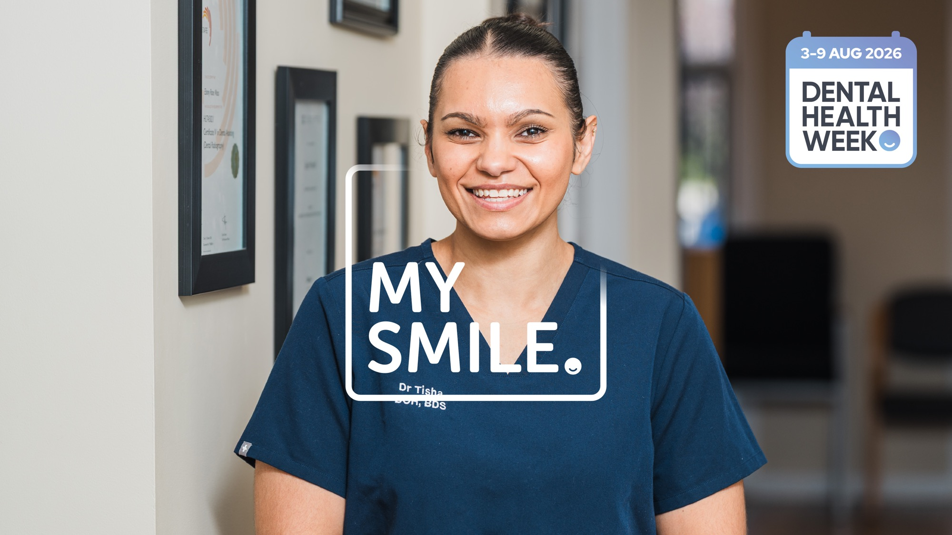
WISDOM TEETH

Slide 5
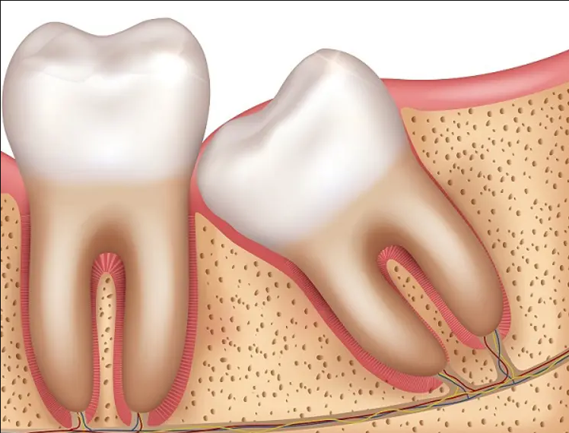
Wisdom teeth:
Your wisdom teeth might start becoming a problem
  The adult third molar teeth are often called ‘wisdom teeth’
  They are the last teeth to appear in the mouth around 18-25 years of age
  Wisdom teeth are often impacted
Impacted wisdom tooth

Slide 6
Impacted wisdom teeth:
Impacted (wisdom teeth): something is stopping the teeth from pushing all the way into the mouth
For example, there may not be enough space between the tooth in front and the bone behind so the tooth can not push all the way into the mouth
Wisdom teeth that are stuck half in the mouth and half under the gums can cause problems:
  Infection
  Pain
  Gum disease
  Tooth decay
  Ulcers
  Cysts

Slide 7
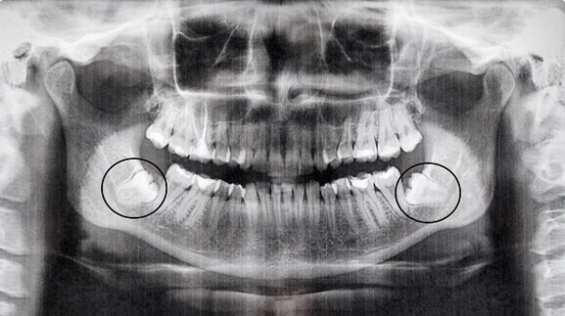
How does my dentist check my wisdom teeth?
Your dentist will look inside your mouth to check
Your dentist may ask to take an xray (radiograph)
Xray shows position of the teeth, the shape of the tooth's roots and if the wisdom teeth are close to important parts of your face
Xray (OPG) showing impacted two lower wisdom teeth

Slide 8
Why are wisdom teeth removed?
Teeth are impacted
Teeth are decayed
Gum around wisdom teeth has been infected (especially multiple times)
Risk of developing tooth decay or gum disease
Affected by a cyst or tumour
Wisdom teeth can be removed by your general dentist or a dental specialist in a dental clinic or hospital setting
Some patients may choose to have additional sedation, including conscious sedation or general anaesthesia when having their wisdom teeth removed

Slide 9
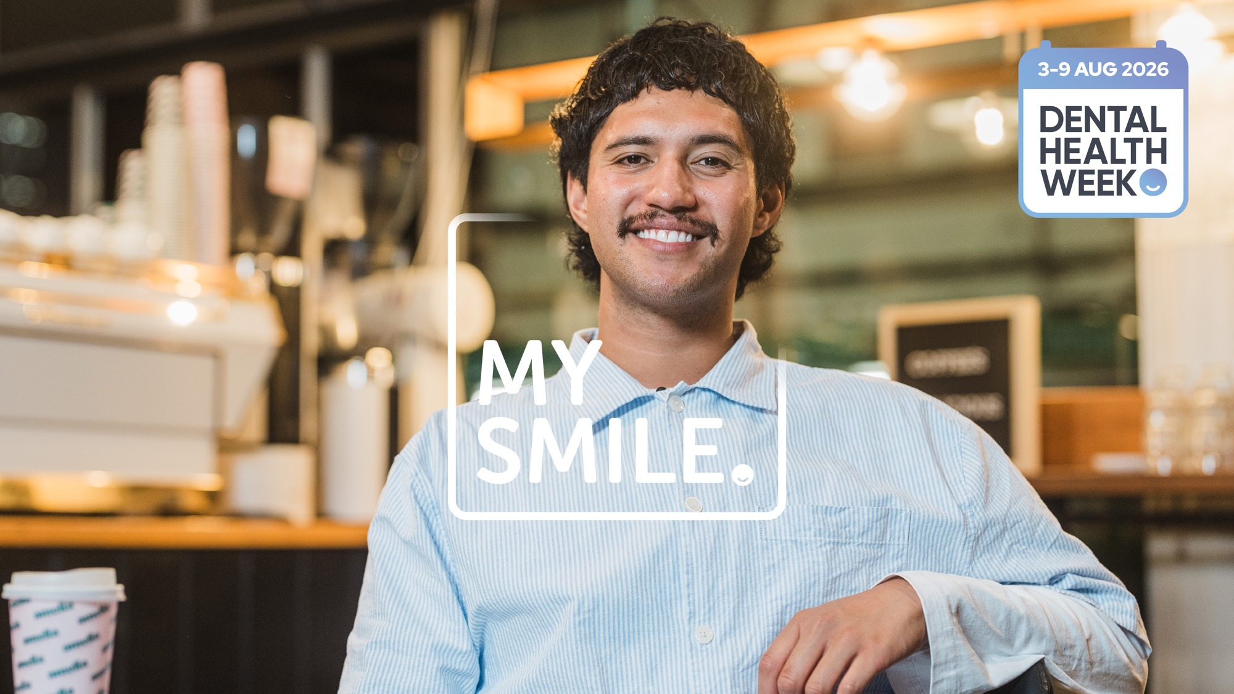
COSMETIC DENTISTRY

Slide 10
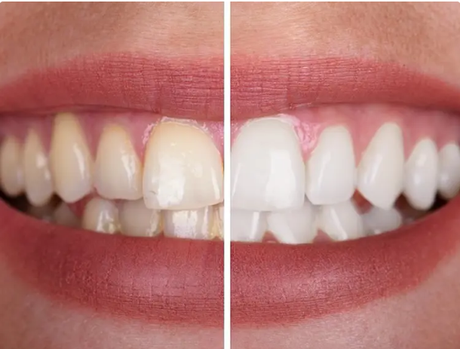
What is cosmetic dentistry?
Cosmetic dentistry focuses on improving the look of your teeth and smile
This may involve changing the shape, colour or position of teeth or replacing missing teeth
Treatments can range from minor fixes, like repairing a chipped tooth, to more complex procedures such as straightening teeth (braces)

Slide 11
What are some common types of cosmetic treatment?
Whitening: Bleaching gel is used at home or in clinic to lighten natural teeth
  This whitens natural tooth structure but does not whiten fillings, dentures or crowns
Orthodontics: Braces or thin clear plastic trays that are used to move teeth position and often straighten teeth
Veneers: Thin layer of filling or ceramic material glued onto the front tooth surface
  Some of the tooth surface may be polished off to create space for the material
Crowns: Ceramic or metal shell that covers your entire tooth
  Removal of tooth structure is usually required to make space for the crown
Implants: A titanium screw placed in the jaw bone, onto which a ceramic tooth is attached, to replace a missing tooth

Slide 12
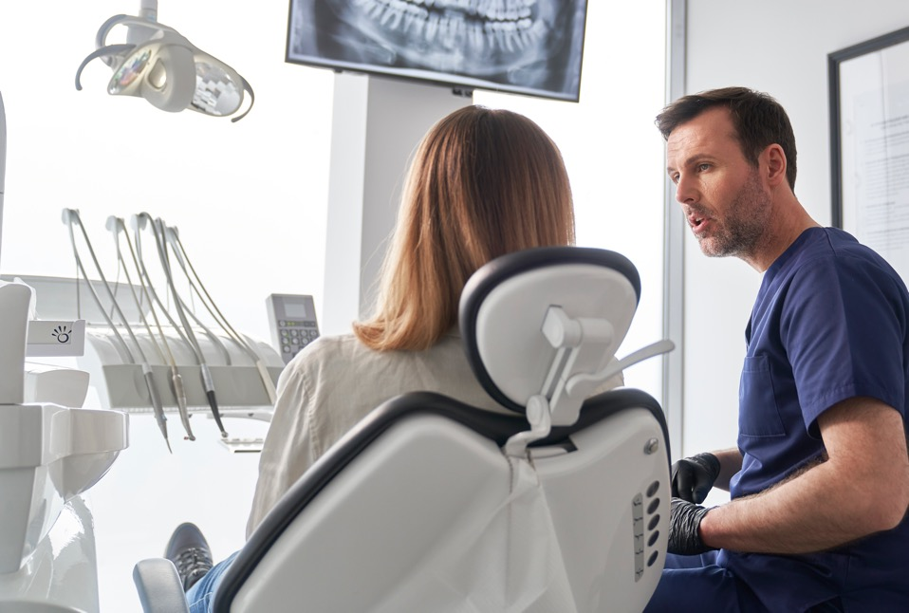
It can be a bit confusing....
Go seek professional dental advice
– not from online sources
This is important to ensure you:
Treat any dental disease first – your health is priority
Identify the cause of the unsatisfactory appearance
Discuss suitable treatment options
Develop a realistic plan that suits your needs (including costs)

Slide 13
Questions to discuss with your dentist
During your appointment with the dentist, talk about your concerns –
you are just as involved in the treatment plan as they are
Ask your dentist about:
What options are available and the pros and the cons of each option?
What results can be reasonably expected?
What costs, time and money is involved?
Any possible side effects or complications?
If it is a complex procedure, you may need time to think about
your options, seek a second opinion or see a specialist

Slide 14
Questions to discuss with your dentist
Ultimately cosmetic dentistry is an often an elective procedure and involves input from both you and your dentist to get a fantastic, safe and long-term cosmetic result
Always seek professional dental advice and be very careful of the information you see online from social media and 'influencers' - they are NOT trained experts

Slide 15
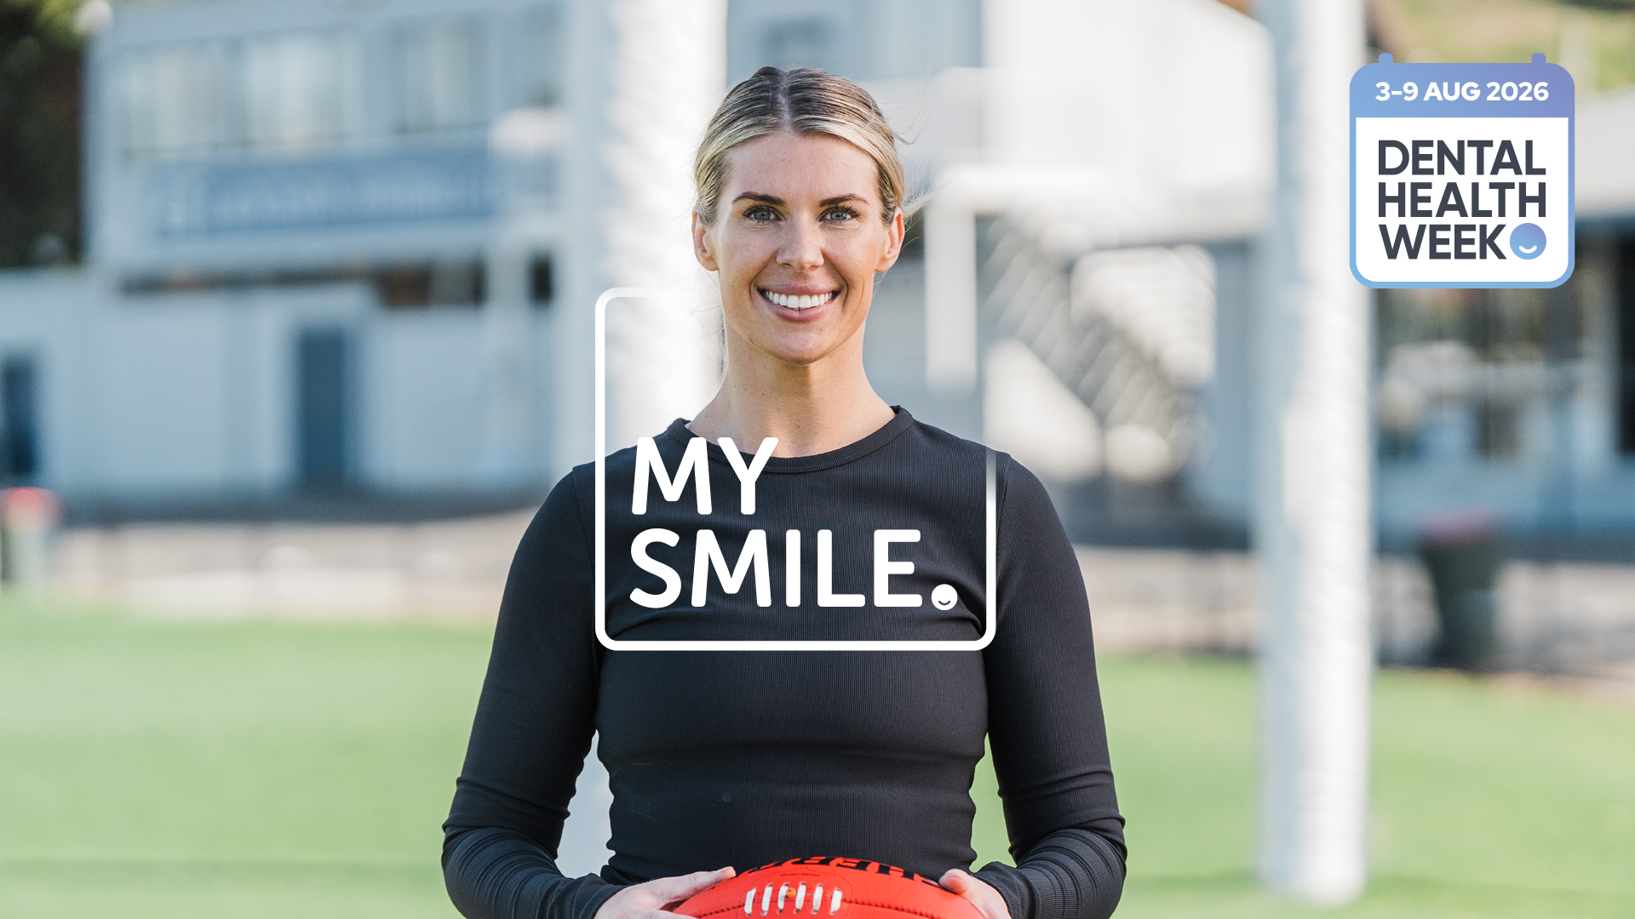
SPORT & DENTISTRY

Slide 16
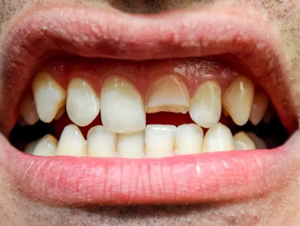
Sports & trauma
Sport can cause irreversible, severe and
long-term injuries to teeth, including:
Cut lips, gums, tongue, cheeks or face
Chipped, cracked or fractured teeth (including nerve damage)
Teeth become loose
Teeth are pushed into gums, backwards or sideways
Teeth are knocked out of the jaw (avulsion)
Broken jaw
Injuries often happen after hours or the weekend. Contact your dentist immediately to review the trauma. If your dentist is unavailable, you can use ADA's Find a Dentist portal

Slide 17
Common sports & leisure activities causing dental trauma
Common sports & leisure activities causing dental trauma:
Cycling, skateboarding and scooter accidents account for ~44% of dental injuries
Sports such as football, boxing, basketball, netball, cricket, hockey and soccer account for up to 14% of dental injuries
Any sport where contact with equipment, collision with other players or falling is possible carries an increased risk
Increased risk of dental injury due to:
NOT wearing a mouthguard
Protrusive (‘buck’) front teeth
Inadequate lip coverage over the front teeth
Current orthodontic treatment
e.g. braces

Slide 18
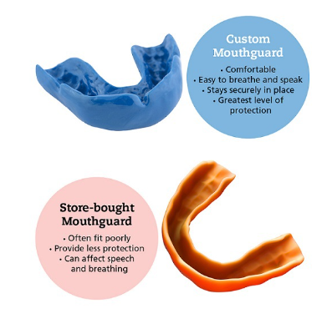
Mouthguards:
Mouthguards need to be worn during both training and official games
'No Mouthguard, no play' policy across several Australian sports clubs
Custom-made mouthguard by your dentist give you the greatest protection
How do mouthguards work?
Mouthguards absorb and spread the impact of the force to the face during a 'knock' = less trauma

Slide 19
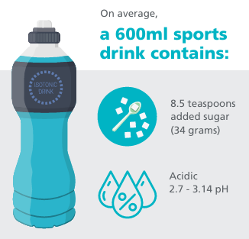
Sports Drinks:
What are Sports Drinks?
Sports drinks are used to rehydrate during or after exercise
Made of water and electrolytes, such as sodium and potassium
Sugar and food acids are also added
Sports drinks may damage your teeth if you drink them too much - they can cause tooth decay and erosion

Slide 20
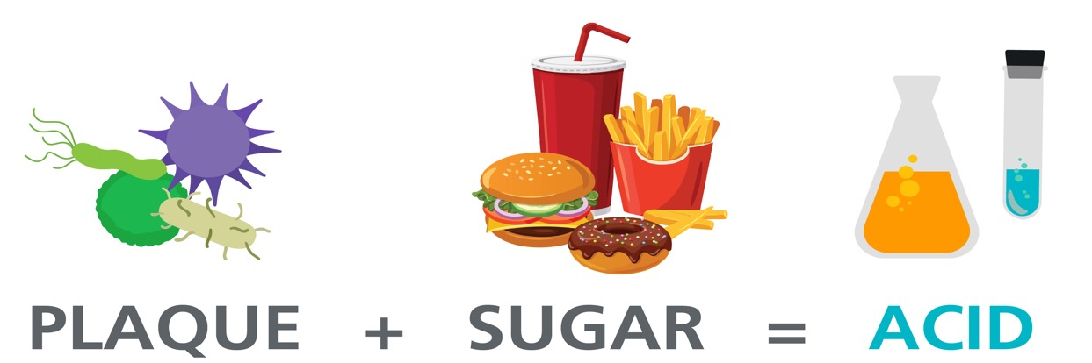
Tooth Decay
Decay is a big problem and sugar is the main culprit
  Sugar from foods and drinks feed the bacteria inside our mouth
  Bacteria uses this energy to make acids
  Acids attack the surface of teeth

Slide 21
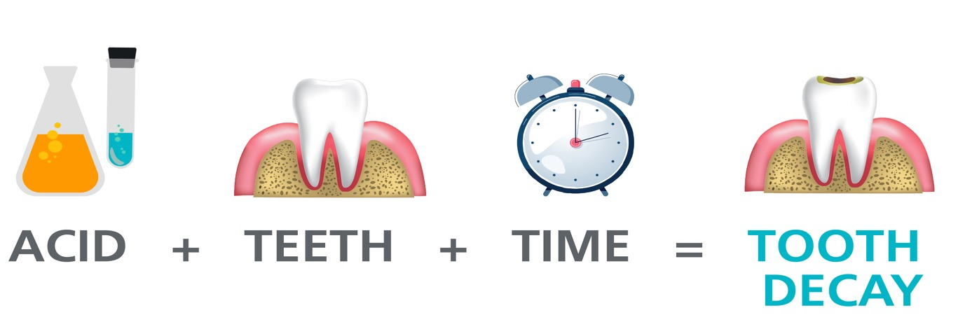
Tooth Decay
This attack dissolves the minerals giving our teeth strength
This makes the tooth weak
If this happens often, we get decay (holes) in our teeth

Slide 22
Tooth Erosion:
Tooth erosion: loss of tooth structure that is dissolved from acids contacting the teeth
Frequent acid contact + long periods of time = increased risk
of tooth erosion
Process of erosion:
1/ Erosion: acids coating tooth surfaces dissolve minerals of outside structure = tooth surface becomes softer
2/ Wear: softened & weakened tooth surfaces are worn away by forces rubbing on teeth e.g. opposing teeth

Slide 23
What can you do to minimise risk of tooth damage?
Water is your safest option to stay hydrated
Do not swish or hold sports drink in your mouth before swallowing it
Have a sip of water after drinking your sports drink
Wait 30 mins after you eat or drink anything to brush your teeth

Slide 24
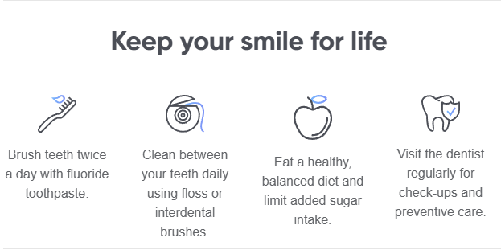
Some closing remarks:
Don't delay seeking dental treatment until things become a big problem!
Preventative care is always cheaper, less invasive and less involved
Simple preventative measures at home

Slide 25
